Slide 1
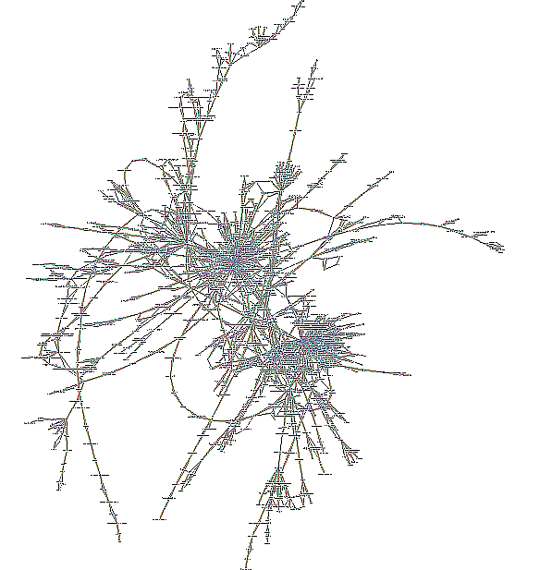
Metabolic network
reconstruction
and
flux balance analysis
Ludovic Cottret
ludovic.cottret@toulouse.inra.fr
M1 MABS Toulouse
Mars 2013

Slide 2
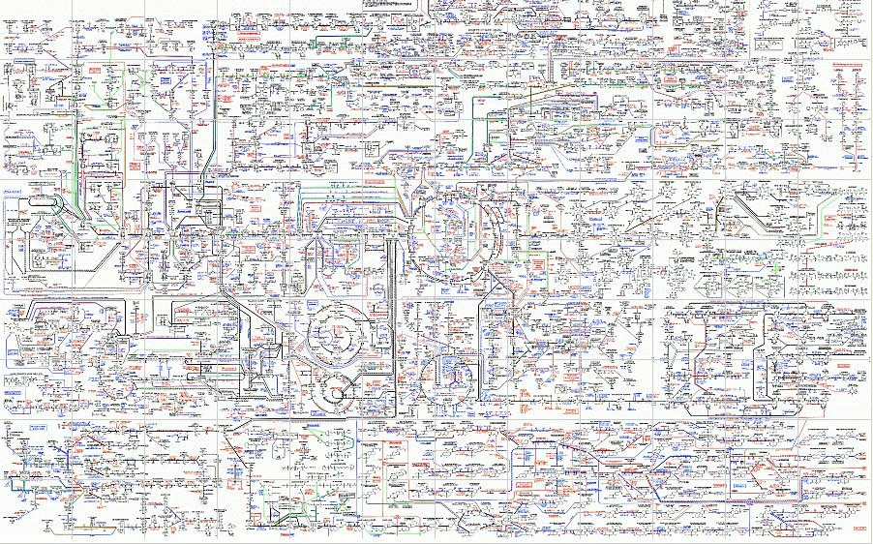
What is a metabolic network ?

Slide 3
From genes to reactions
Genes
Genomics
Notes:
It's important to keep in mind that the metabolic network is linked to other molecular interaction networks and that they form together only one big network.
Here, I figure a dna strand with genes in blue.

Slide 4
From genes to reactions
Genes
Genomics
Transcription
RNAs
Transcriptomics
Notes:
Each gene is transcribed in RNA

Slide 5
From genes to reactions
Genes
Genomics
Transcription
RNAs
Transcriptomics
Translation
Proteins
Proteomics
Notes:
that can be translated in proteins. These proteins can form complexes.

Slide 6
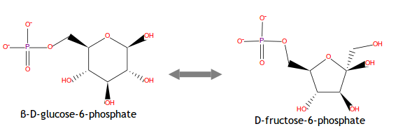
From genes to reactions
Genes
Genomics
Transcription
RNAs
Transcriptomics
Translation
Proteins
Proteomics
Catalysis
Reactions
and
metabolites
Metabolomics
Fluxomics
Notes:
And at last, proteins and proteic complex can catalyse reactions.
Each layer corresponds to different molecular interaction networks. For instance, proteins can control the transcription of some genes, forming what we call the regulatory network. And the physical interactions between the proteins form the protein-protein network.
Each layer is experimentally defined by distinct omics technics and it's why that they are classically studied separately. But in fact we have to think these network as a whole. And now that each one of these technics becomes quite cheap, we can integrate them in a single network.
Each layer is also regulated by different factors and you can see in this diagram that the metabolic network constitute the end product of these regulations. Then, by integrating information that come from each layer, the analysis of the metabolic network is a way to analyse the effects of these different regula

Slide 7
From genes to reactions
Genes
Transcription
RNAs
Translation
Proteins
Catalysis
Reactions
and
metabolites
PHENOTYPE
Notes:
And at last, proteins and proteic complex can catalyse reactions.
Each layer is experimentally defined by distinct omics technics and it's why that they are classically studied separately. But in fact we have to think these network as a whole. And now that each one of these technics becomes quite cheap, we can integrate them in a single network.
Each layer is also regulated by different factors and you can see in this diagram that the metabolic network constitute the end product of these regulations. Then, by integrating information that come from each layer, the analysis of the metabolic network is a way to describe a phenotype.

Slide 8
From genes to reactions
Genes
GENETICS
Transcription
RNAs
Translation
Proteins
Catalysis
ENVIRONMENT
Reactions
and
metabolites
PHENOTYPE
Notes:
So, the analysis of the metabolic network is a way to explore the links between genetics, environment and phenotype.
But first, we have to reconstruct the metabolic network, what means establishing the list of the reactions occuring in a cell and the links between these different layers.

Slide 9
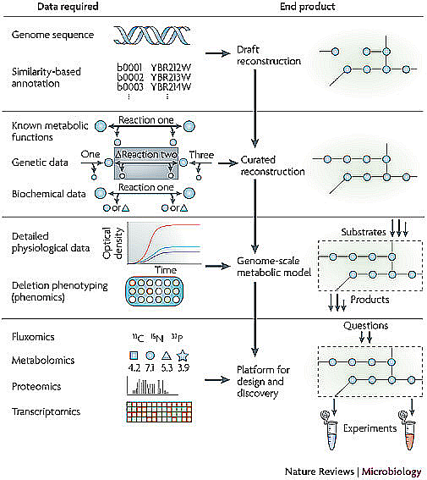
Metabolic network and model reconstruction
Metabolic Network
→ Database
exploration
→ Graph models
Metabolic Model
→ Flux analysis
Reconstruction of biochemical networks in microorganisms Feist et al. 2009. Nature Reviews | Microbiology
Notes:
A complete metabolic network reconstruction can be divided into four major steps, each one is built from the previous one. The model generated from each reconstruction step can be used to examine a growing number of questions.
The initial step produces a draft reconstruction from automatic genome annotation that returns a list of potential catalytic activities. By consulting metabolic databases such as KEGG or BioCyc, it is possible to thus obtain a first list of reactions. However, this list of reactions contains false positive and missing reactions. The second step uses genetic or biochemical data to curate the reconstruction.
The third step is the reconstruction of a genome-scale model allowing flux analyses. To perform this step, the bounds of the model must be determined, what means that the inputs and the outputs of the metabolic system have to be known. This model already allows to mimic the cell metabolism and to check the reconstruction by comparing results of simulations with physiological or phenomics data.
The fourth step integrates in the metabolic model data from other omics experiments such as fluxomics, metabolomics, proteomics or transcriptomics. Their integration in the model allows to deal with very complex biological questions.

Slide 10
Metabolic network and model reconstruction
1 day !
Metabolic Network
→ Database
exploration
→ Graph models
> 1 year !!!!
Metabolic Model
→ Flux analysis
Reconstruction of biochemical networks in microorganisms Feist et al. 2009. Nature Reviews | Microbiology
Notes:
The great limitation in using such models is the time to build them. Indeed, the automatic metabolic reconstruction of an organism requires only one day but the following steps require at least one year and require many manual and tedious tasks.
This is clearly a bottleneck in the analysis of a metabolic network and one of my job is to develop tools to reduce this time.

Slide 11
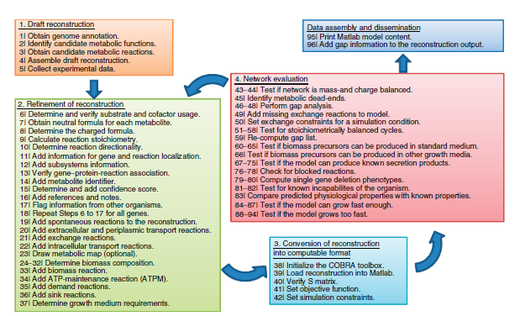
A long task...
Thiele & Palsson (2010) Nature Protocol

Slide 12
First draft reconstruction

Slide 13
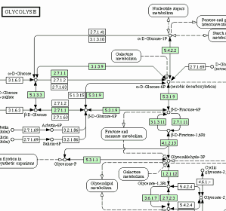
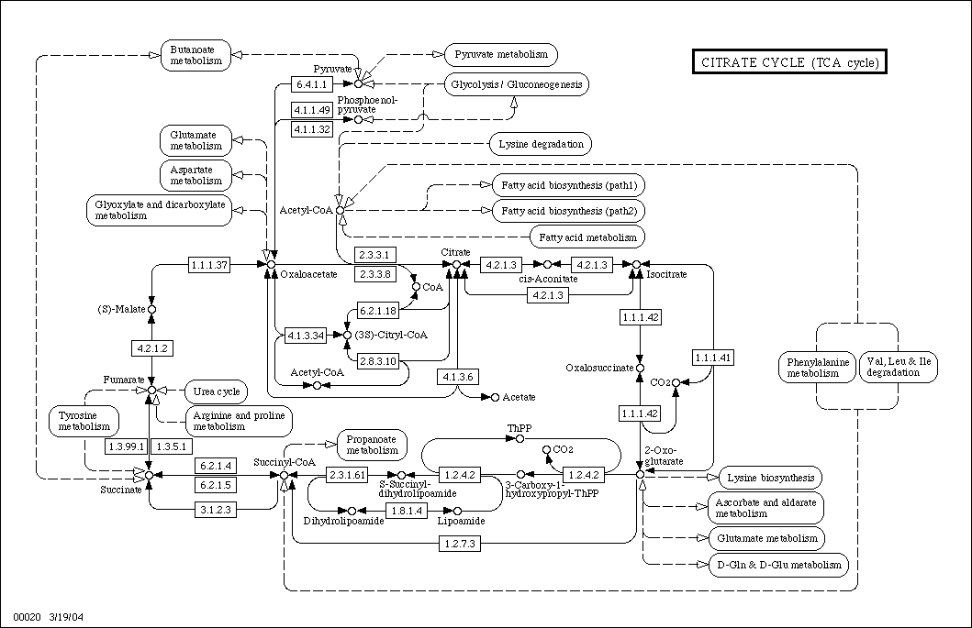
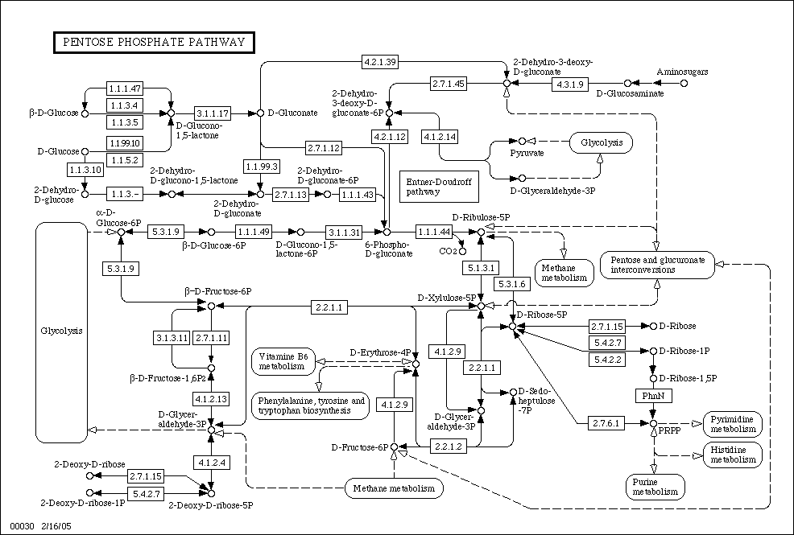
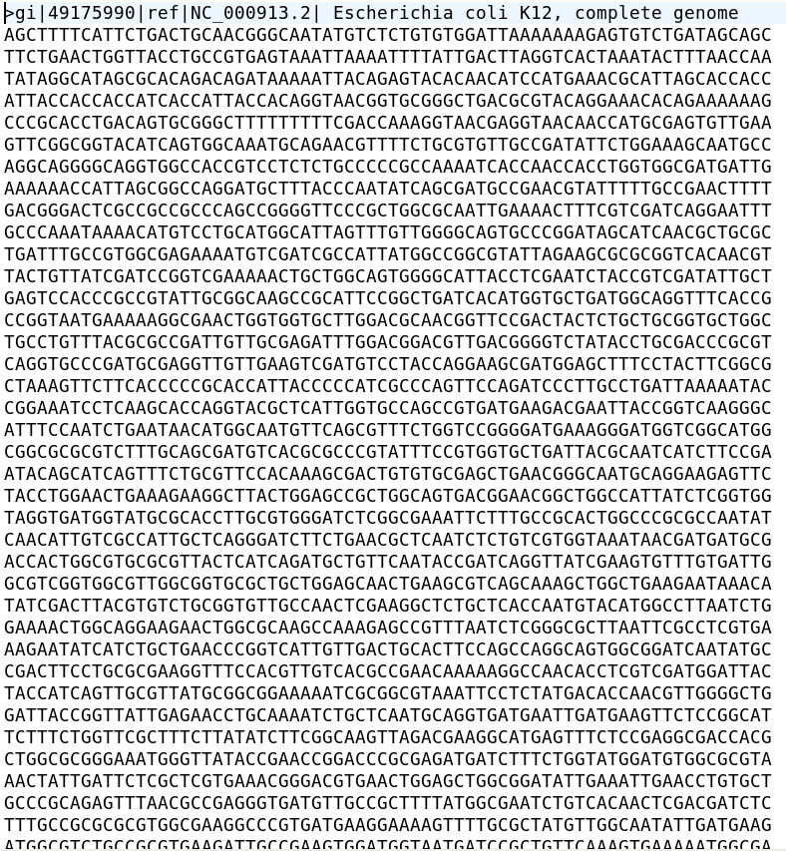
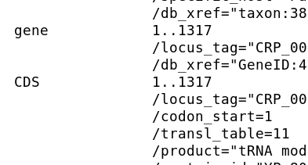
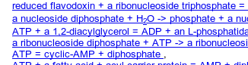


Automatic draft reconstruction
ANNOTATION
Metabolic pathways
Reactions
List of metabolic functions
EC number: X.X.X.X
Name of the enzymatic
activity
...

Slide 14
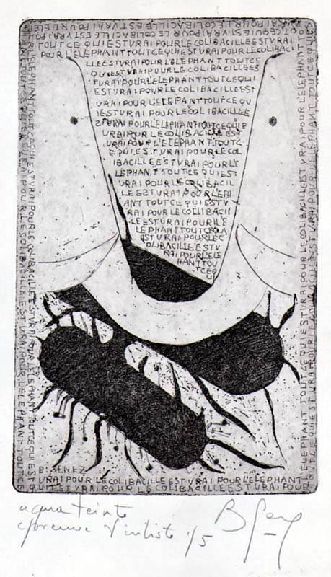
Point de départ : l'annotation fonctionnelle du génome
“Ce qui est vrai pour le colibacille est vrai pour l'éléphant”
Jacques Monod
L'annotation fonctionnelle se fait principalement par comparaison avec les annotations d'organismes modèles.

Slide 15
Rappels : homologie, orthologie, paralogie et analogie
Les gènes homologues ont un ancêtre commun
Les gènes orthologues sont des homologues qui ont divergé après un évènement de spéciation
Les gènes paralogues sont des homologues qui ont divergé après un évènement de duplication
Les gènes analogues ne sont pas homologues mais ont la même fonction

Slide 16
Assignements par homologie : hypothèses
Deux gènes (protéines) dont la séquence est proche sont susceptibles de coder pour la même fonction
Les orthologues sont supposés avoir la même fonction
La fonction des paralogues est supposé avoir divergé

Slide 17
Annotation fonctionnelle des gènes
Limitations
Les orthologues n'ont pas toujours la même fonction
Certains paralogues récents peuvent partager la même fonction
Les groupes d'orthologues de référence sont le plus souvent inférrés automatiquement : propagation d'erreurs
Impossible de détecter les analogues
40 % des gènes n'ont pas de fonction
40 % des enzymes n'ont pas de gène assigné

Slide 18
Informations additionnelles
Profiles phylogénétiques
Synténie
Fusion de protéines
Corégulation
Pour les gènes métaboliques : analyse du réseau métabolique
...

Slide 19
Des annotations aux réactions
Listes de gènes métaboliques
?
Listes de réactions

Slide 20
Les bases de données pour faire le lien entre EC numbers et réactions
ENZYME
BRENDA
KEGG
BioCyc, MetaCyc
Rhea

Slide 21
Définir les voies métaboliques à partir des réactions
Par comparaison avec les voies métaboliques de référence :
  KEGG : en allumant les gènes dans les cartes métaboliques
  Pathway-Tools (BioCyc) : en établissant des règles pour définir la présence ou l'absence d'une voie métabolique
Par analyse du réseau métabolique
  Chemins dans les graphes
  Modes élémentaires

Slide 22
Outils de reconstruction automatique du réseau métabolique
KAAS (KEGG) : à partir de séquences brutes, classe chaque gène dans un groupe d'orthologues et retourne les cartes métaboliques avec les réactions identifiées
Pathologic (BioCyc) : à partir d'annotations existantes, retourne une liste de voies métaboliques
Model Seed : à partir de séquences brutes, retourne une liste de scénarios possibles et un réseau métabolique global
PRIAM : à partir de séquences brutes, retourne une liste de numéros EC potentiels et les cartes métaboliques KEGG avec les réactions identifiées

Slide 23
Limitations des reconstructions automatiques
Erreurs provenant de l'annotation du génome
Spécificité des enzymes (un même EC peut correspondre à plusieurs réactions)
Réactions manquantes
Réactions génériques (ex: 1.1.1.1 : an alcohol + NAD+ → an aldehyde or ketone + NADH)
Direction des réactions non assignée
Compartimentation
Erreur dans la formulation des réactions
Prédiction incorrecte des voies métaboliques

Slide 24
How to obtain a better first draft ?

Slide 25
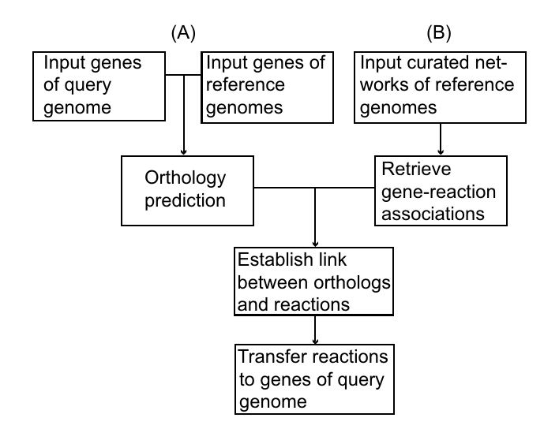
Propagation from curated metabolic models
Integrated in TheSeed
Accelerating the reconstruction of genome-scale metabolic networks. Notebaart et al. 2006.

Slide 26



Merge several draft reconstructions
PRIAM
MERGE
Draft reconstruction

Slide 27
Reconciliation of metabolic annotations
MetRxn : incorporates data from 8 different metabolic databases and 90 genome-scale metabolic models
Rhea : freely available, manually annotated database of chemical reactions created in collaboration with the Swiss Institute of Bioinformatics (SIB)
Chebi : The database and ontology of Chemical Entities of Biological Interest

Slide 28
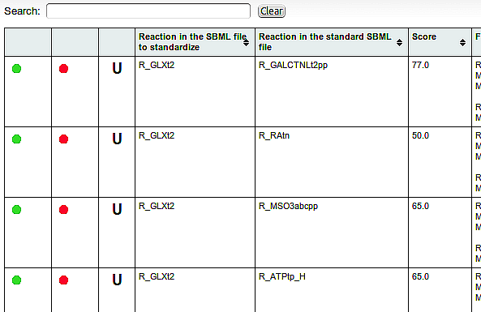
Example of bioinformartics help to reconciliate networks

Slide 29
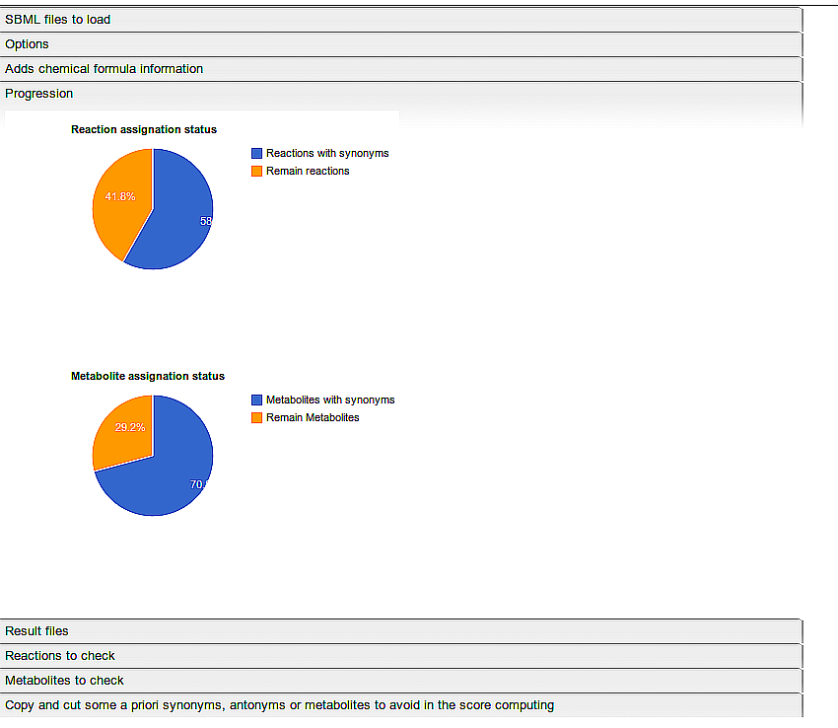
Example of bioinformartics help to reconciliate networks

Slide 30
Metabolic network curation

Slide 31
Correction de la spécificité des réactions
Utilisation de BRENDA qui contient la spécicité d'enzymes chez de nombreux organismes
Vérification de la disponibilité de tous les substrats et cofacteurs
Assignation de la spécificité grâce à un organisme de référence proche de l'organisme étudié

Slide 32
Identification des réactions manquantes
Ajouter les réactions spontanées
Sur la base des voies métaboliques identifiées : Pathway Hole Filler dans PATHOLOGIC
Test de scénarios : The Seed

Slide 33
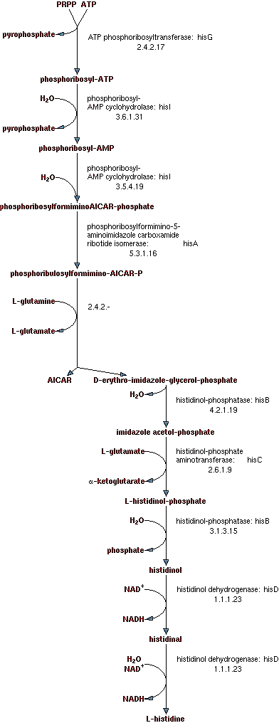
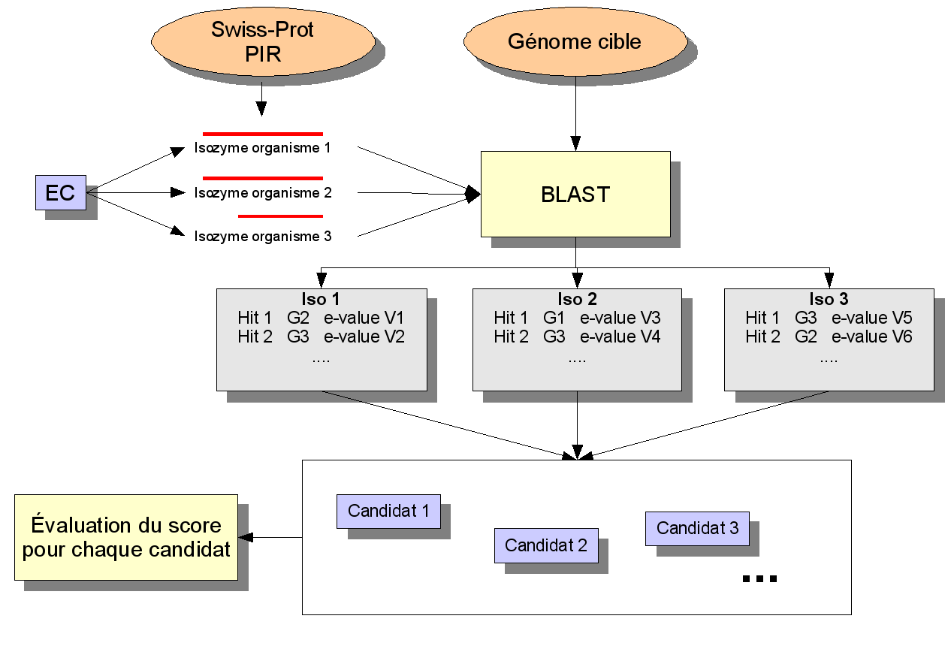
Pathway Hole Filler

Slide 34
Réactions génériques
Préciser les substrats et les produits : aucune méthode automatique ne fait pour l'instant cette opération
  Utiliser les bases de données métaboliques et les métabolites déjà présents dans le réseau

Slide 35
Direction des réactions
Sur la base des voies métaboliques identifiées
Grâce à l'analyse des contraintes topologiques et stoechiométriques du réseau métabolique (Kümmel, A.; Panke, S. & Heinemann, M. Systematic assignment of thermodynamic constraints in metabolic network models BMC Bioinformatics, 2006, 7, 512)

Slide 36
Compartimentation
Utilisation des données de protéomique
Recherche de signatures dans les séquences
Prise en compte de réactions a priori localisées et des contraintes du réseau global (Mintz-Oron, S.; Aharoni, A.; Ruppin, E. & Shlomi, T. Network-based prediction of metabolic enzymes' subcellular localization. Bioinformatics, 2009, 25, i247-i252)

Slide 37
Erreurs dans la formulation des réactions
Coefficients stoechiométriques erronés
Métabolites manquants (ex : H+)

Slide 38
Metabolic network
edition and sharing

Slide 39
Exchange formats
SBML : centré sur les réactions et sur la modélisation
BioPax : contient d'autres informations que les réactions

Slide 40
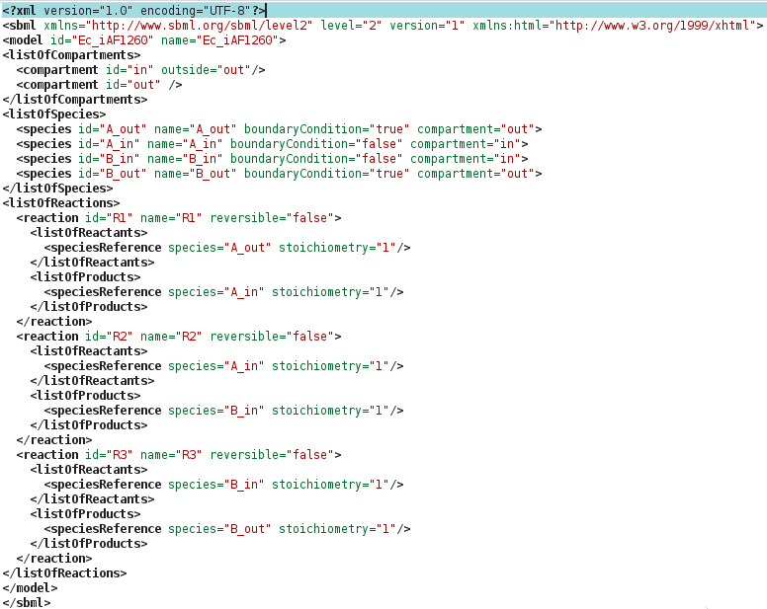
Raw SBML

Slide 41
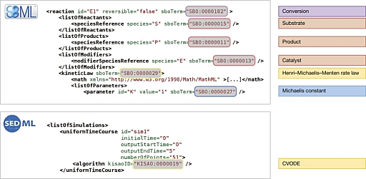
SBML annotations : SBO terms
Systems Biology Ontology

Slide 42
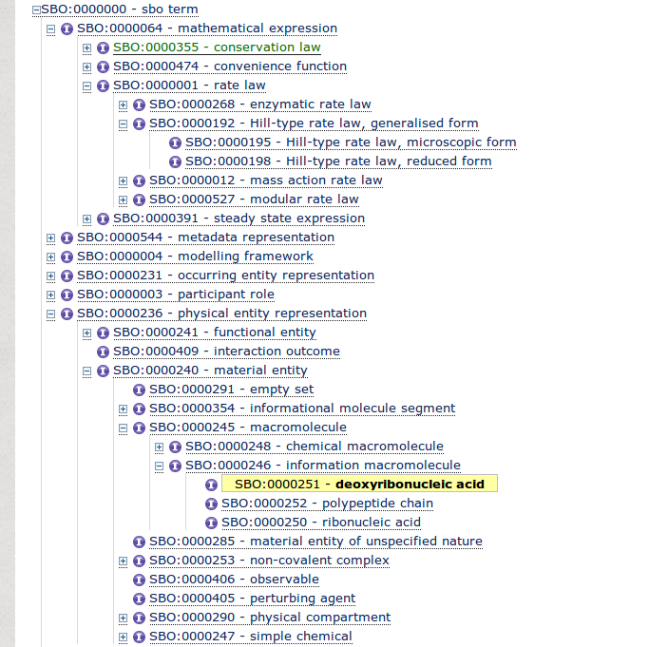
SBO terms

Slide 43
Minimum information requested in the annotation of biochemical models (MIRIAM)
Description complète du modèle (auteurs, date de création, etc...)
Description des entités grâce à des urls
Le Novère et al. Nature Biotechnology 2005

Slide 44
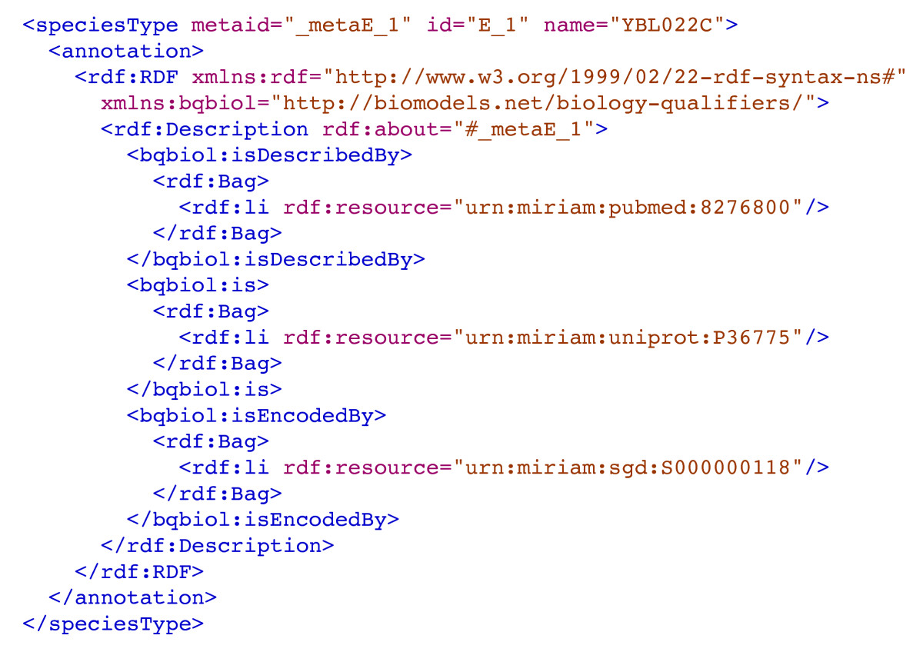
Minimum information requested in the annotation of biochemical models (MIRIAM)

Slide 45
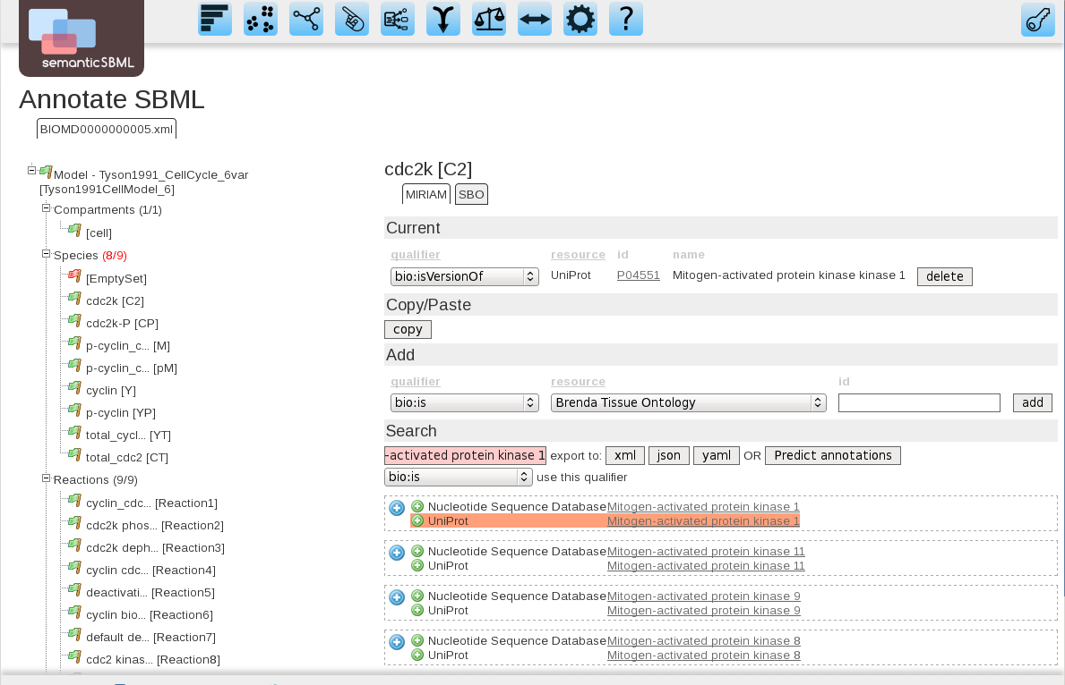
SemanticSBML

Slide 47
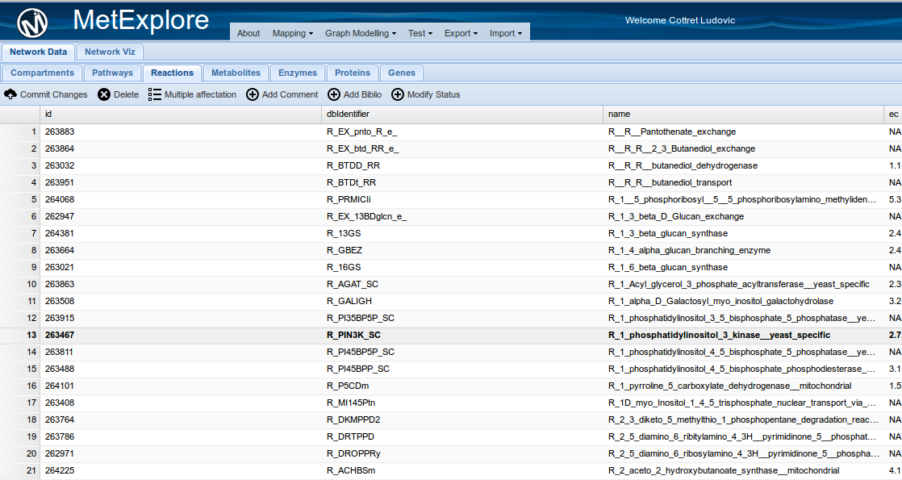
Edition and sharing
The raw way : SVN or Github
MetExplore 2

Slide 48
Metabolic network exploration

Slide 49
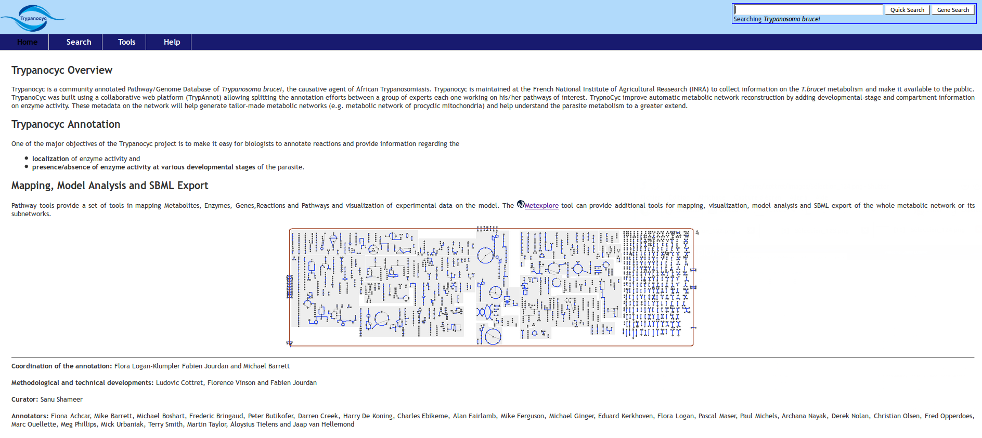
BioCyc-like pages from the pathway-tools

Slide 50
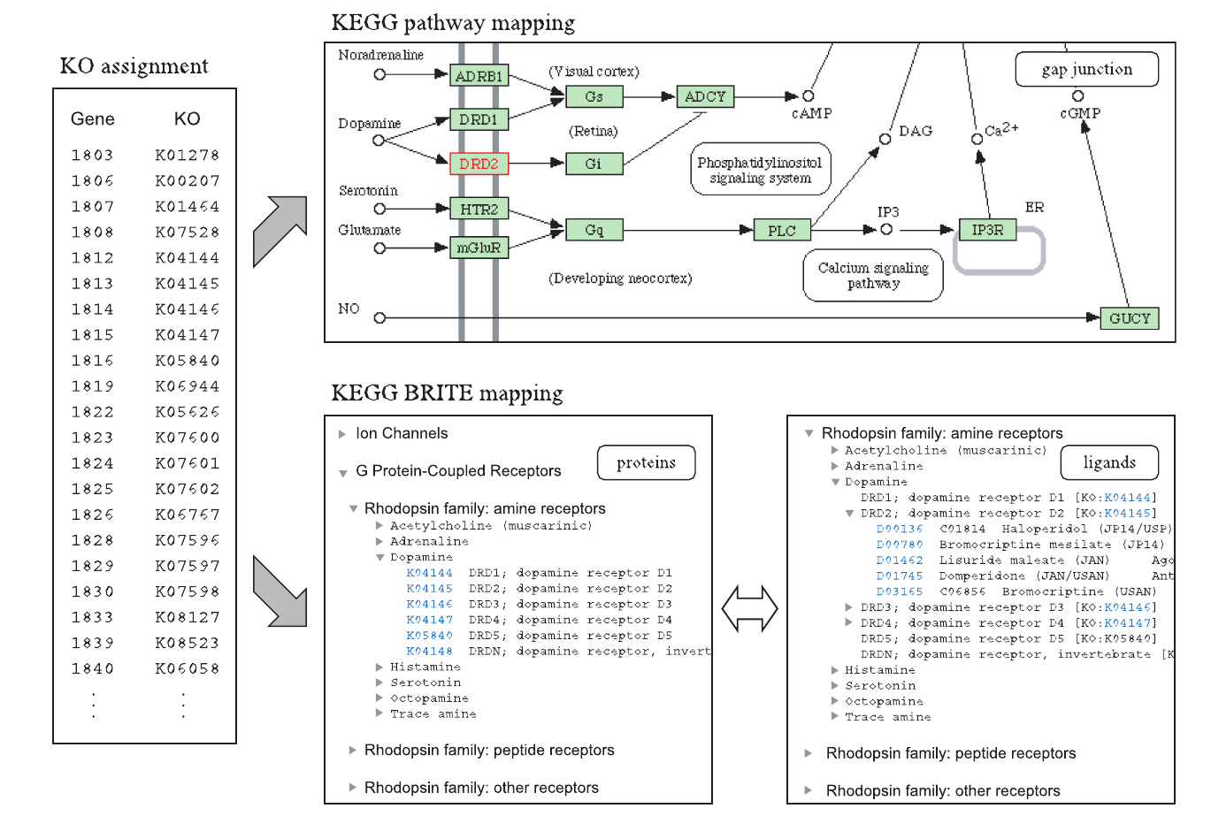
KEGG pathways

Slide 51
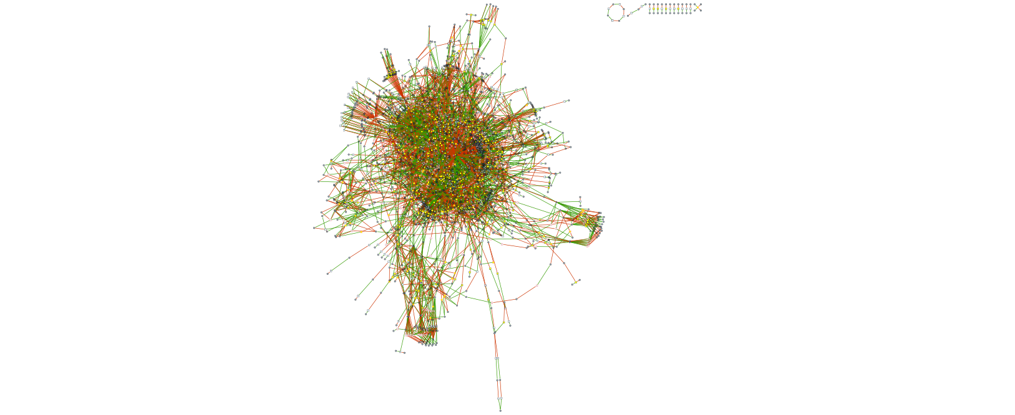
Network visualisation
Cytoscape
Tulip (systrip plugin)
Vanted
Javascript libraries : cytoscape.js, d3.js, etc...
MetExplore via Cytoscape Java and javascript

Slide 52
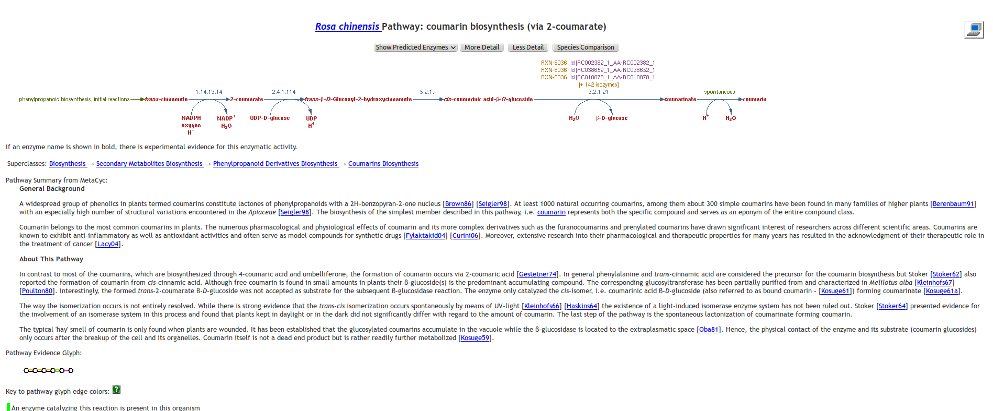
What else ?
omics
Metabolic
reconstruction
Curation
Metabolic
network
Exploration
Notes:
Well, once you have built your network, you can explore it by visualising it or by browsing pathways in specific databases. Of course, you can answer intersting questions by doing it. However, the questions that you will be able to answer will be limited.

Slide 53
The metabolic network is a complex system
Notes:
Indeed, a metabolic network can be composed by thousands of reactions.
Mathematically speaking, it's a complex system, what means that it's impossible to predict its behaviour only by studying its elementary components.
To predict general behavoiour, modelling is necessary.

Slide 54
From the metabolic network to the metabolic model
Metabolic
network
Metabolic
model
Exploration
Inference
of
emergent
properties
Notes:
So, from a metabolic network, we have to build a metabolic model that will allow us to infer emergent properties of the system.

Slide 55
Two ways to model genome scale networks
Metabolic Graphs
Flux models
Notes:
Two main frameworks exist for modelling genome-scale metabolic networks : the graphs and the flux models.

Slide 56
Flux analysis principle
Notes:
The second framework consists in the flux analysis models called also constraint based models.
Originally, constraint based models have been designed to supply the lack of kinetic parameters at the genome scale level. So, the generic principle is to compute a flux distribution, what means a rate for each reaction, considering flux constraints indicated by the modeller.

Slide 57
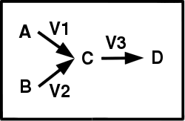
Flux analysis principle
Metabolic network
Notes:
Let's take a small example with only three reactions, corresponding to three flux or rate values, V1, V2 and V3

Slide 58
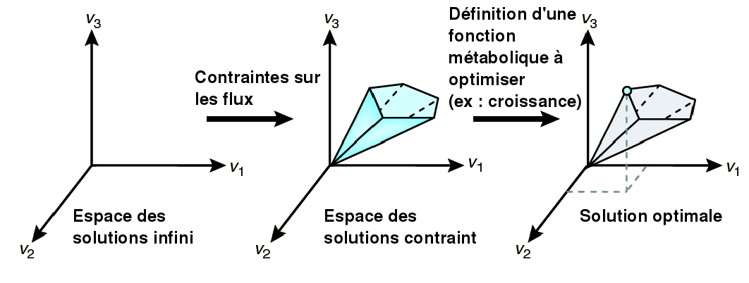
Flux analysis principle
Metabolic network
Infinite
space of solutions
0 ≤ V1 ≤ ∞
0 ≤ V2 ≤ ∞
0 ≤ V3 ≤ ∞
0 < V1 < 2.5
0 < V2 < 3
0 < V3 < 4
V1 = 2
V2 = 2.5
V3 = 4
Notes:
Now, let's draw a plot with the 3 values V1, V2 and V3, that will figure the flux distribution.
Without any constraint on the fluxes, the space solution is infinite.

Slide 59
Flux analysis principle
constraints
on fluxes
Metabolic network
Infinite
space of solutions
constrained
space of solutions
0 ≤ V1 ≤ ∞
0 ≤ V2 ≤ ∞
0 ≤ V3 ≤ ∞
0 ≤ V1 ≤ 2.5
0 ≤ V2 ≤ 3
0 ≤ V3 ≤ 4
V1 +V2 -V3 = 0
V1 = 2
V2 = 2.5
V3 = 4
(steady state
constraint)
Notes:
L'ajout de contraintes sur les flux permet de réduire l'espace des solutions, c'est à dire les distriibutions de flux possibles.
Adding constraints on the fluxes allows to reduce the solution space. Note that one constraint is always present in flux analyses : the steady sate, what means that every quantity of metabolite produced must be consumed,

Slide 60
Flux analysis principle
Minimal distributions
(Elementary modes)
V1 = 2
V2 = 2
V3 = 4
V1 = 1
V2 = 3
V3 = 2
constraints
on fluxes
V1 = 1
V2 = 3
V3 = 2
V1 = 1
V2 = 3
V3 = 2
V1 = 1
V2 = 3
V3 = 2
Metabolic network
Infinite
space of solutions
constrained
space of solutions
Definition of
an objective function
0 ≤ V1 ≤ ∞
0 ≤ V2 ≤ ∞
0 ≤ V3 ≤ ∞
0 ≤ V1 ≤ 2.5
0 ≤ V2 ≤ 3
0 ≤ V3 ≤ 4
V1 +V2 -V3 = 0
One optimal
distribution
(steady state
constraint)
Flux
Balance
Analysis
V1 = 2
V2 = 2
V3 = 4
Notes:
Ensuite, la définition par le modélisateur d'une fonction objective, c'est à dire d'un flux ou d'un ensemble de flux à optimiser permet aux algorithmes de programmation linéaire de retourner une distribution des flux qui optimise cette fonction objective et répond aux contraintes indiquées.
Par exemple ici, ce point correspond à la distribution des flux qui maximise v3, sachant les contraintes sur les flux v1, v2, et v3.
Now, you can compute all the possible minimal flux distributions that fit the constraints. This corresponds to what we call elementary flux modes. However, this can be rarely applicable on genome scale metabolic networks because of their great number (more than one million).
What is classicaly done in genom scale models is to define an objective function, for instance the cell growth, and to compute a distribution flux that optimizes this objective function. For instance here, this flux distribution maximizes the flux V3 But be careful, with this method, you obtain one optimal flux distribution but other optimal flux distribution can exist.

Slide 61
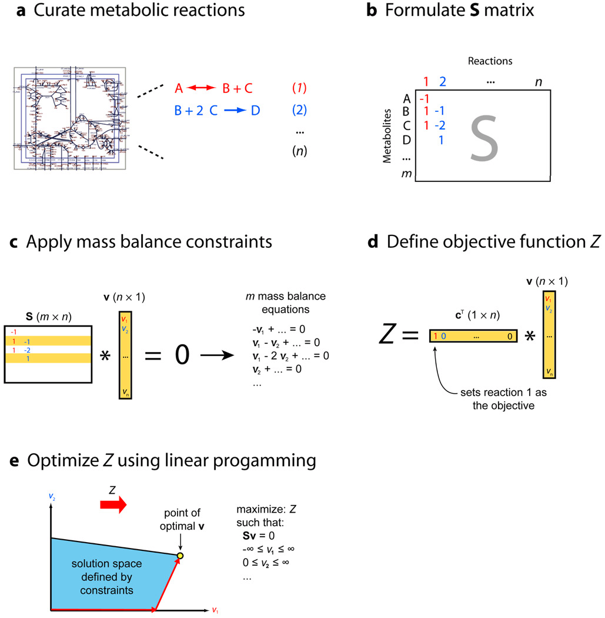
Formulation of a FBA problem
What is flux balance analysis? Jeffrey D. Orth, Ines Thiele, and Bernhard Ø. Palsson. Nat Biotechnol., 2011

Slide 62
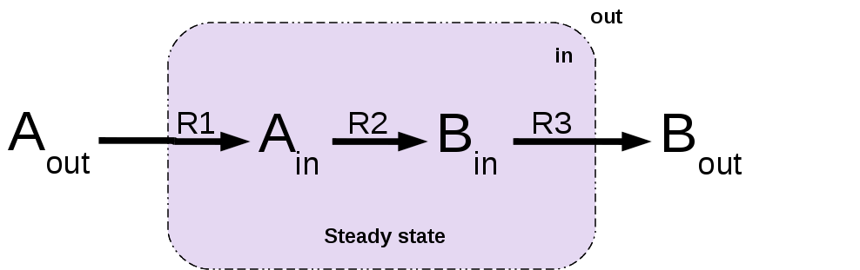
Steady state assumption

Slide 63
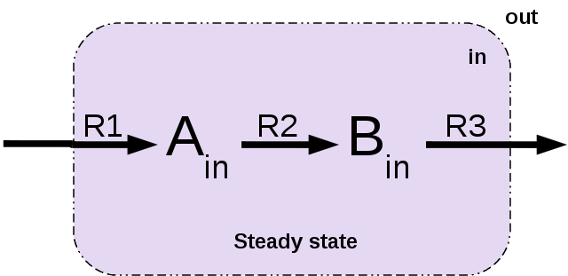
Steady state assumption

Slide 64
Biomass reaction
Fake reaction whose the substrates are all the cell components and growth requirements.
The stoichiometric coefficients correspond to the relative proportion of each component in the biomass composition.

Slide 65
The starting point : the SBML file

Slide 66
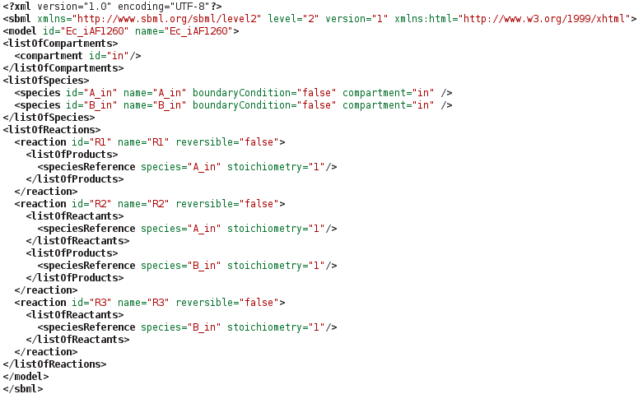
The starting point : the SBML file

Slide 67
Additional requirements for building flux models
Reactions must be balanced
Identification of dead reactions (reactions that are not able to carry any flux)
Identification of dead metabolites (metabolites that are not balanced) : needs to add exchange reactions
Lower and upper bounds for each reaction
Biomass reaction
Media that enable growth
Add ATP and growth requirement reactions
Add Gene Protein Reaction links

Slide 68
The tools
Cobra-Toolbox
Opt-Flux
FASIMU
Surrey-FBA
MetExplore
FlexFlux

Slide 69
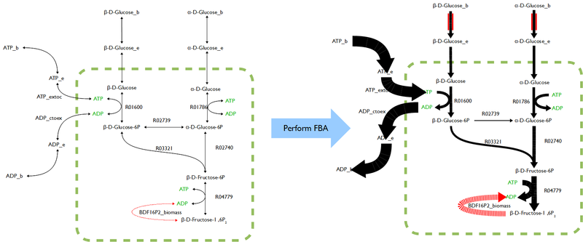
Metabolic flux map
Source : Wikipedia
Notes:
What can we do once computing an optimal flux distribution or elementary modes ?
First we can map the results on the metabolic network to see how the flux are distributed among several conditions or constraints.

Slide 70
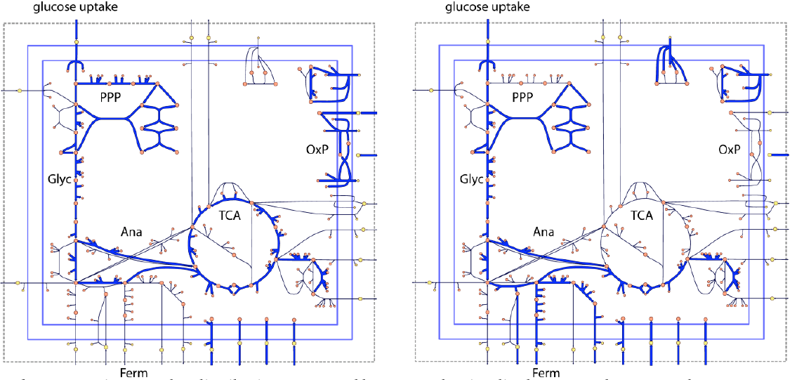
Computing optimal growth rate
biomass
production
Optimal
growth rate
Notes:
The objective function can correspond to the biomass production. So you can easily compute the optimal growth rate of a cell in some constraints

Slide 71
Environmental constraints
Notes:
The constraints can be environmental for instance by removing or limiting nutrient input fluxes.

Slide 72
Genetic constraints
Notes:
They can be genetic for instance by simulating knock out of genes corresponding to reactions.

Slide 73
Essential genes
Essential genes
Notes:
Flux analyses allows to identify the reactions and genes essential to the biomass production or to any metabolic function.

Slide 74
Physiological modules
Essential genes
Physiological modules
Notes:
Flux analysis allows also to identify physiological modules, what means set of reactions whose the fluxes are coupled together.

Slide 75
Physiological modules
Essential genes
Physiological modules
Notes:
Elle permet également d'identifier les gènes dont les flux sont couplés, c'est à dire qui dépendent les uns des autres. Ceci permet d'établir des modules physiologiques.

Slide 76
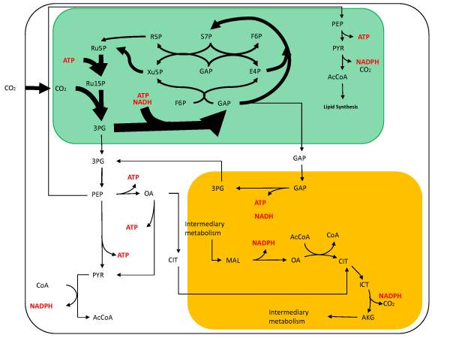
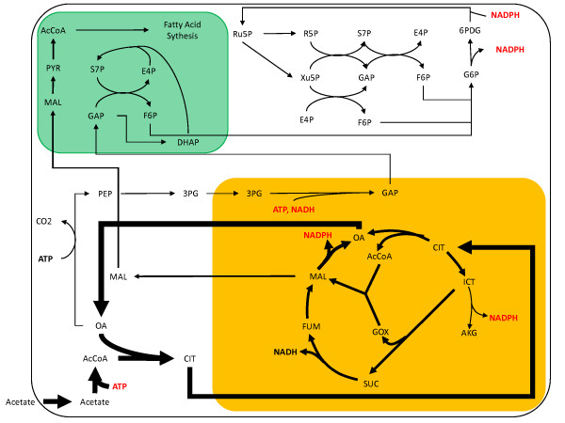
Redistribution of fluxes
Autotrophic metabolism
Heterotrophic metabolism
Boyle, N. R. & Morgan, J. A. Flux balance analysis of primary metabolism in Chlamydomonas reinhardtii. BMC Syst Biol, School of Chemical Engineering, Purdue University, West Lafayette, Indiana 47907, USA. nboyle@purdue.edu, 2009, 3, 4
Notes:
Here is an example of a flux analysis in a unicellular plant in autotrophic and heterotrophic conditions. We can see easily a complete redistribution of the fluxes between the two conditions.

Slide 77
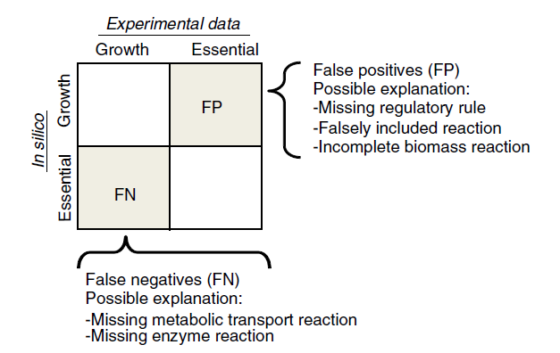
Model checking (1)
Essential genes
Thiele 2010. Nature Protocols.

Slide 78
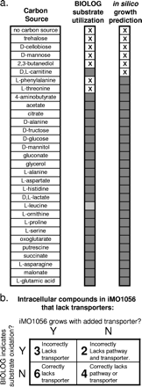
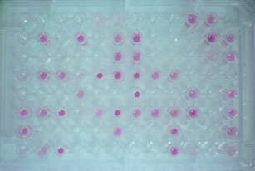
Model checking (2)
Biolog profile
Oberhardt et al. J. Bacteriol. 2008

Slide 79
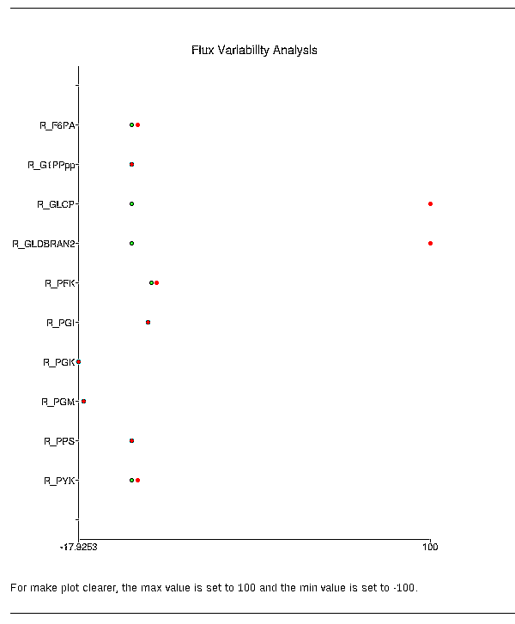
Flux variability analysis
source : http://metexplore.toulouse.inra.fr

Slide 80
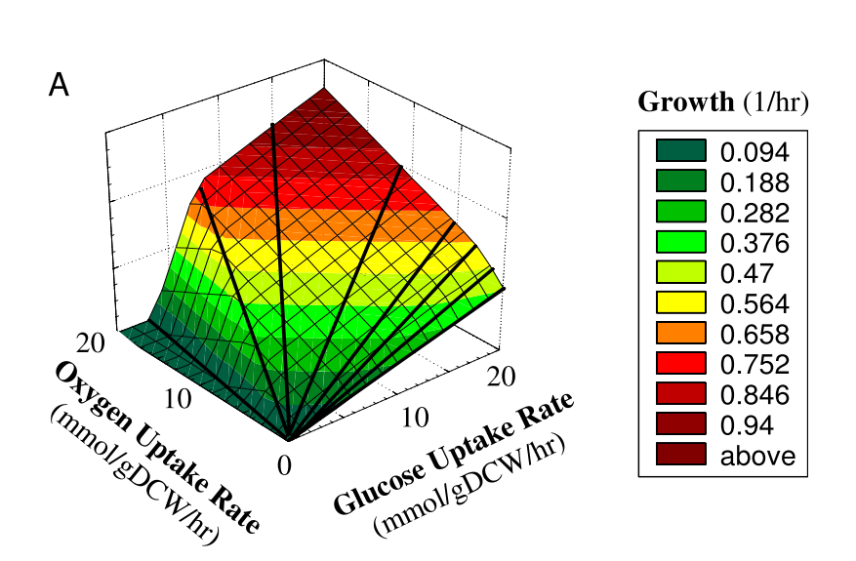
Phenotypic phases
Integrated analysis of metabolic phenotypes in Saccharomyces cerevisiae. Duarte et al. BMC Genomics 2004.
Notes:
An other example. Here the authors, thanks to FBA, described in yeast the quantitative relationship between a primary
carbon source (glucose) uptake rate, oxygen uptake rate, and maximal cellular growth
rate. They vary in silico the first flux, the second flux, and they compute the optimal growth rate for each pair of vlalues. They obtain a plot in 3D. You can see that this plot is divided in several planes. Each plane corresponds to different network behaviours.

Slide 81
Phenotypic phases
Glucose is completely oxidized to produce biomass
Integrated analysis of metabolic phenotypes in Saccharomyces cerevisiae. Duarte et al. BMC Genomics 2004.
Notes:
This red line corresponds to the line of optimality : glucose is completely oxidized to produce biomass.

Slide 82
Phenotypic phases
Oxygen limited. Excess in mitochondrial NAD+ → production of
acetate and ethanol
Integrated analysis of metabolic phenotypes in Saccharomyces cerevisiae. Duarte et al. BMC Genomics 2004.
Notes:
For instance, this phase corresponds to a limitation in O2.

Slide 83
Phenotypic phases
Three glycolysis reactions become essential
Integrated analysis of metabolic phenotypes in Saccharomyces cerevisiae. Duarte et al. BMC Genomics 2004.
Notes:
In this phase, the Oxygen is again less available. Three gycolysis reactions become essential.

Slide 84
Phenotypic phases
The pentose phosphate pathway is used to generate NADPH
because not enough NADPH is produced through respiration
Integrated analysis of metabolic phenotypes in Saccharomyces cerevisiae. Duarte et al. BMC Genomics 2004.
Notes:
During this phase, the respiration is not sufficient to produce NADPH. Then, it is generated by the PPP.

Slide 85
Phenotypic phases
Acetate is not produced anymore. Ethanol is secreted as
the only metabolic by-product to balance the redox potential of the cell.
Integrated analysis of metabolic phenotypes in Saccharomyces cerevisiae. Duarte et al. BMC Genomics 2004.
Notes:
At last, in this phase, acetate is not produced anymore. There is only secretion of ethanol.

Slide 86
Optimisation de souches microbiennes par knock-outs
P1
Engineering
objective
Substrate uptake
I1
B
Cellular
objective
S1
R1
R2
R4
P2
Undesired
by-product
R3
I2
R5
Inspired by Kim et al. 2010. BMC Syst. Biol.

Slide 87
Optimisation de souches microbiennes par knock-outs
P1
Engineering
objective
Substrate uptake
I1
B
Cellular
objective
S1
R1
R2
R4
P2
Undesired
by-product
R3
I2
R5
OptKnock method identifies reaction deletions
leading to the overproduction of metabolites
while ensuring the growth maintenance
Burgard et al. 2003. Optknock: a bilevel programming framework for identifying gene knockout strategies for microbial strain optimization.Biotechnol Bioeng, 84, 647-657

Slide 88
Optimisation de souches microbiennes par knock-outs
P1
Engineering
objective
Substrate uptake
I1
B
Cellular
objective
S1
R1
R2
R4
P2
Undesired
by-product
R3
I2
R5
OptKnock method identifies reaction deletions
leading to the overproduction of metabolites
while ensuring the growth maintenance
Burgard et al. 2003. Optknock: a bilevel programming framework for identifying gene knockout strategies for microbial strain optimization.Biotechnol Bioeng, 84, 647-657

Slide 89
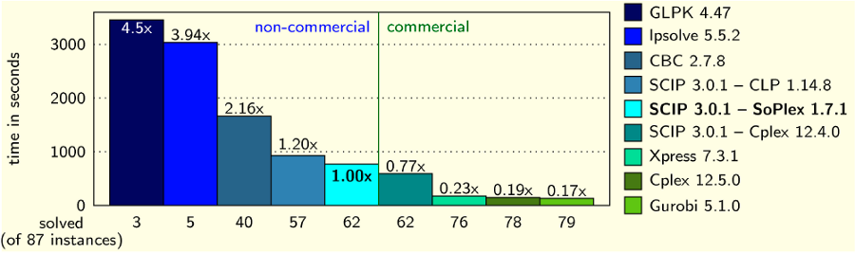
How to make your own FBA tool ? (1)
By using optimizers !
- CPLEX
- GLPK
- SCIP
- Gurobi...

Slide 90
Flux balance analysis formulation problem. Example
Objective function
V2
C
V4
Maximize
obj: v_biomass
Subject To
c1: v_ex_a - v1 = 0
c2: v1 - v2 - v3 = 0
c3: v2 - v4 = 0
c4: v3 - v5 = 0
c5: - v_biomass + v4 + v5 = 0
Bounds
0 <= v_biomass <= 10000
0 <= v_ex_a <= 10
0 <= v1 <= 9
0 <= v2 <= 8
-6 <= v3 <= 6
0 <= v4 <= 10
0 <= v5 <= 100
End
Aex
VexA
A
V1
B
Biomass
Vbiomass
Biomass_ex
V3
D
V5

Slide 91
How to make your own FBA tool ? (2)
By using already existing libraries :
- Cobra-Toolbox (matlab)
- Surrey FBA (C)

Slide 92
The tools
Cobra-Toolbox
FASIMU
Surrey-FBA
Opt-Flux
MetExplore
FlexFlux

Slide 93
Cobra-toolbox
Version Matlab and Python
Widely used
Numerous tools
Sometimes badly coded

Slide 94
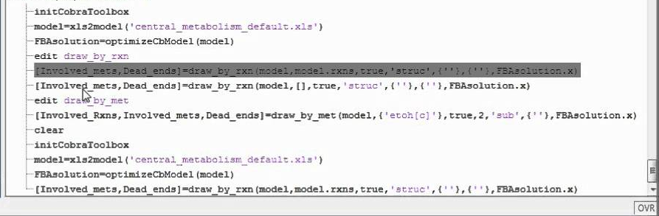
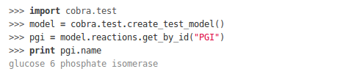
Cobra-Toolbox

Slide 95
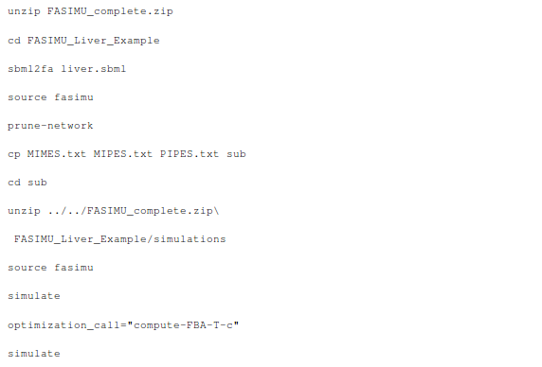
FASIMU
Based on batch scripts
Many functions
Generates many intermediate files
Very slow

Slide 96
SurreyFba
Developed in C
Java interface JyMet
Quite slow
Maintained ?

Slide 97
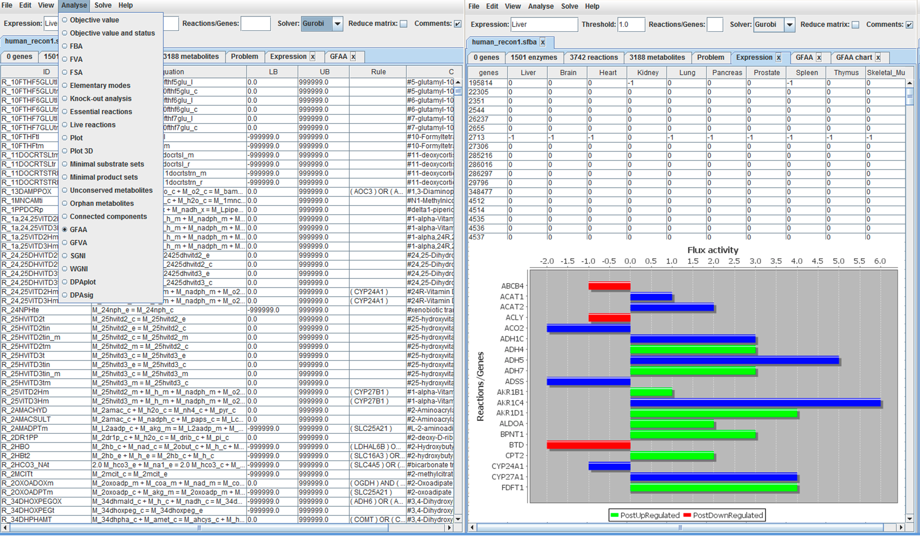
SurreyFBA

Slide 98
OptFlux
User friendly graphical interface
Workspace concept
Stores the environmental and genetic constraints

Slide 99
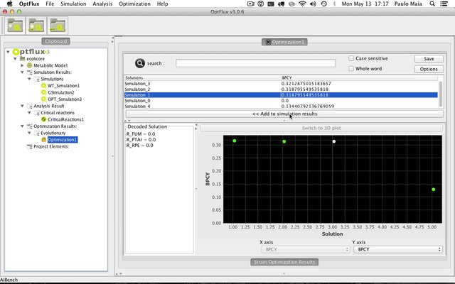
OptFlux

Slide 100
MetExplore
Integrates Surrey-FBA functions
Facilitates the tuning of the flux constraints
Facilitates the visualisation via Cytoscape

Slide 101
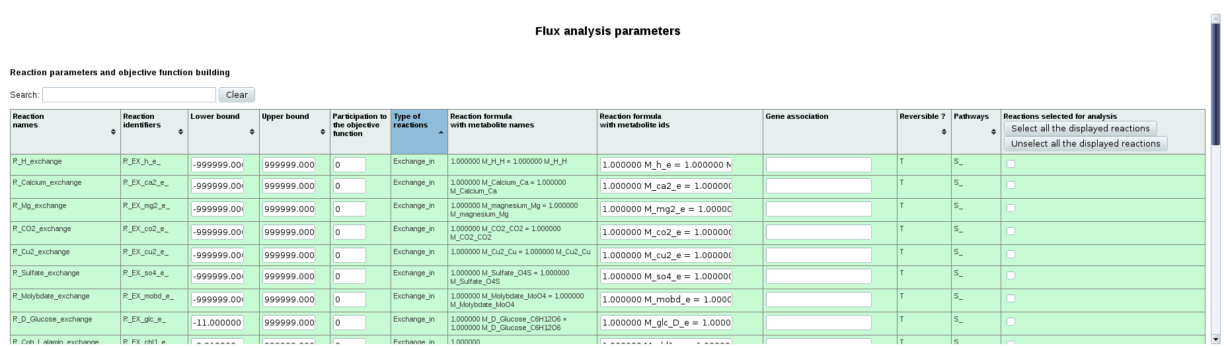
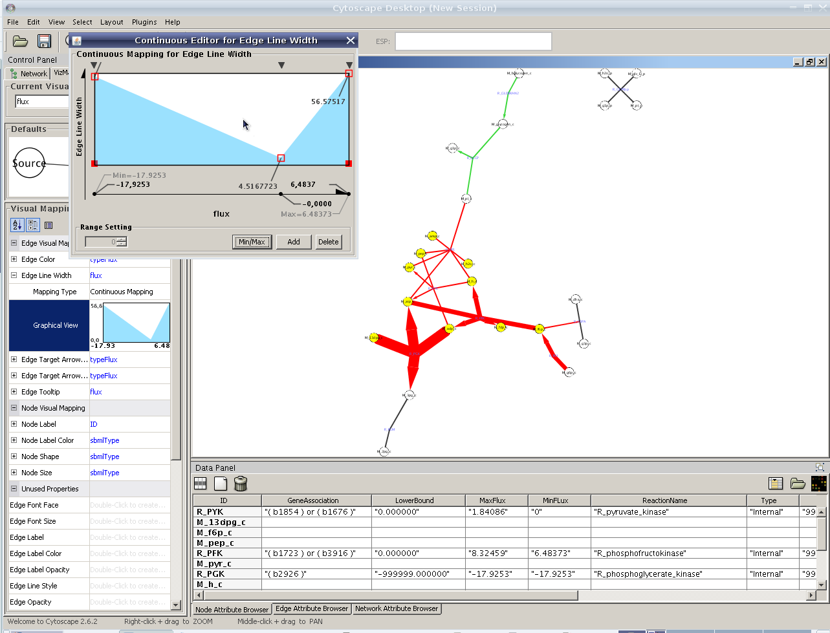
MetExplore

Slide 102
FlexFlux
Java library
Developed in a modular way
Natively integrates regulatory constraints
Very fast

Slide 103


FlexFlux

Slide 104

Flux analysis : advantages and drawbacks
Semi-quantitative analysis without kinetic parameters
Allows to answer complex questions
Needs a well curated metabolic network
Results highly depend on the a priori constraints

Slide 105
KEGG

Slide 106
KEGG en quelques mots
Projet initié en 1995 à l'université de Kyoto
Définition (Kanehisa 2006) : base de connaissances pour comprendre les fonctions de haut niveau d'un système biologique, à partir d'informations génomiques et chimiques

Slide 107

KEGG : une vue très simplifiée

Slide 108
KEGG ORTHOLOGY (KO)
Chaque gène de KEGG GENES est classé selon la fonction pour laquelle il code.
Ainsi,les gènes orthologues et paralogues qui ont
gardé la même fonction se verront attribuer le même numéro KO.
La classification KO se fait en fonction des voies métaboliques présentes dans KEGG.
Ludovic

Slide 109

KEGG ORTHOLOGY (KO)

Slide 110
KEGG PATHWAY
Collection de cartes dessinées manuellement représentant des voies métaboliques, des réseaux de gènes ou des voies de transduction du signal. 156,646 cartes générées à partir de 416 voies métaboliques de référence.

Slide 111

KEGG PATHWAY

Slide 112

KEGG PATHWAY

Slide 113
KEGG : outils associés
KEGG API : service WEB utilisant SOAP (Simple Object Access Protocol) et WSDL (Web Services Description Language). Permet de développer des scripts Ruby, Perl, Java, etc...
KAAS : Annotation fonctionnelle d'un ensemble de gènes par BLAST
SIMCOMP / SUBCOMP : Recherche de structures de composés similaires
e-zyme : Assignation de numéros EC à partir d'un ensemble de substrats et de produits.
Blast, Fasta
MOTIF : recherche de motifs dans les séquences protéiques (recherche de domaines) et dans les séquences nucléiques (recherche de régions promotrices)
CLUSTALW / MAFFT / PRRN : alignements multiples
KGML : Format d'échange (XML)

Slide 114
KEGG : avantages et limitations
+ Nombreux organismes
+ Informations précises sur les composés
+ Nombreux outils associés
+ Reconstruction des données métaboliques possible à partir d'un génome non annoté
- Difficile de s'y retrouver dans le site
- Manque d'expertise

Slide 116
BioCyc en quelques mots
Université de Stanford (1994)
Collection de PGDBs (Pathway Genome DataBase) spécifique à un organisme (mis à part Metacyc)
Trois niveaux d'expertise :
  6 bases à haut niveau d'expertise (Ecocyc, Metacyc, HumanCyc, AraCyc, YeastCyc, LeishCyc)
  34 bases à moyen niveau d'expertise
  1653 bases sans expertise
Partage des bases et expertise par d'autres groupes (Aracyc, HumanCyc...)

Slide 117

BioCyc : les voies métaboliques

Slide 118

BioCyc : vue d'ensemble de la cellule

Slide 119

BioCyc : les réactions

Slide 120

BioCyc : les composés

Slide 121

BioCyc : recherches avancées

Slide 122
BioCyc : les outils associés
Pathway Tools Software : ensemble d'outils de navigation, d'édition et de création de PGDBs
  Dévelopé en LISP, fonctionne sous Linux, Sun et Mac OS X
  Des librairies Java et Perl (javacyc et perlcyc) permettent d'utiliser les fonctions LISP internes aux Pathway Tools
  Pathologic : création de PGDBs locales à partir de Metacyc
  Edition et transformation de l'ontologie de Biocyc
  Possibilité de construire facilement un portail internet avec ses propres PGDBs
  Formats d'échange : fichiers plats, SBML, BioPax
Outils en ligne :
Blast, Fasta
Analyse comparative des données de plusieurs organismes
Visualisation de données expérimentales sur la vue d'ensemble des voies métaboliques

